Slide 1
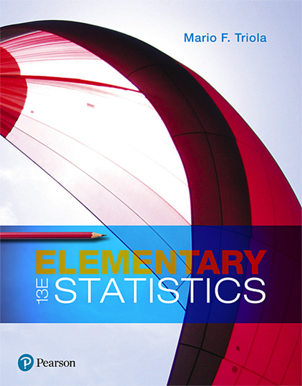
Elementary Statistics
Thirteenth Edition
Chapter 6
Normal Probability Distributions
Copyright © 2018, 2014, 2012 Pearson Education, Inc. All Rights Reserved

Slide 2
Normal Probability Distributions
6-1 The Standard Normal Distribution
6-2 Real Applications of Normal Distributions
6-3 Sampling Distributions and Estimators
6-4 The Central Limit Theorem
6-5 Assessing Normality
6-6 Normal as Approximation to Binomial

Slide 3
Key Concept
We now consider the concept of a sampling distribution of a statistic. Instead of working with values from the original population, we want to focus on the values of statistics (such as sample proportions or sample means) obtained from the population.

Slide 4
General Behavior of Sampling Distributions (1 of 4)
When samples of the same size are taken from the same population, the following two properties apply:
Sample proportions tend to be normally distributed.
The mean of sample proportions is the same as the population mean.

Slide 5
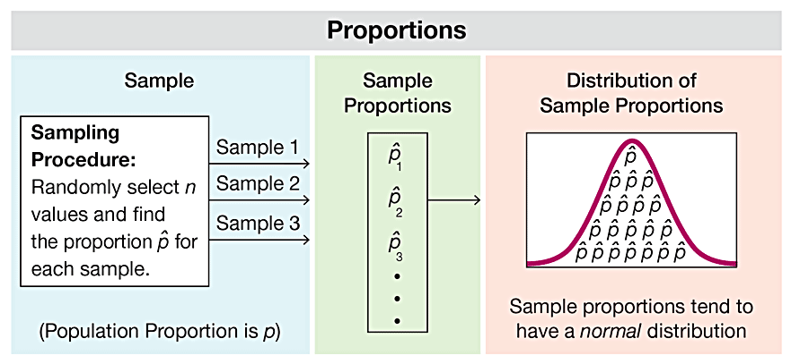
General Behavior of Sampling Distributions (2 of 4)

Slide 6
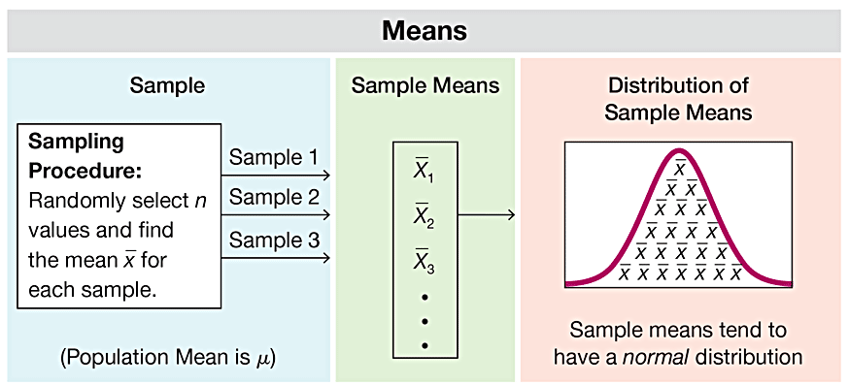
General Behavior of Sampling Distributions (3 of 4)

Slide 7
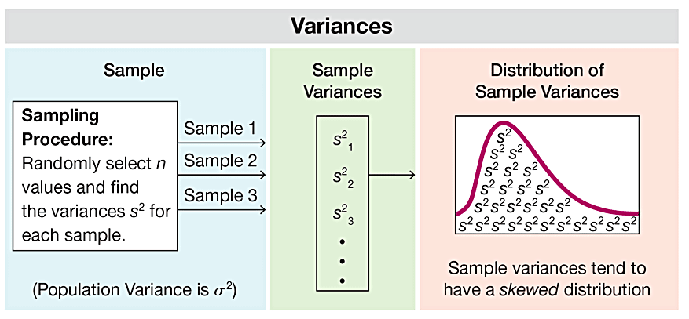
General Behavior of Sampling Distributions (4 of 4)

Slide 8
Sampling Distribution of a Statistic
Sampling Distribution of a Statistic
The sampling distribution of a statistic (such as a sample proportion or sample mean) is the distribution of all values of the statistic when all possible samples of the same size n are taken from the same population. (The sampling distribution of a statistic is typically represented as a probability distribution in the format of a probability histogram, formula, or table.)

Slide 9
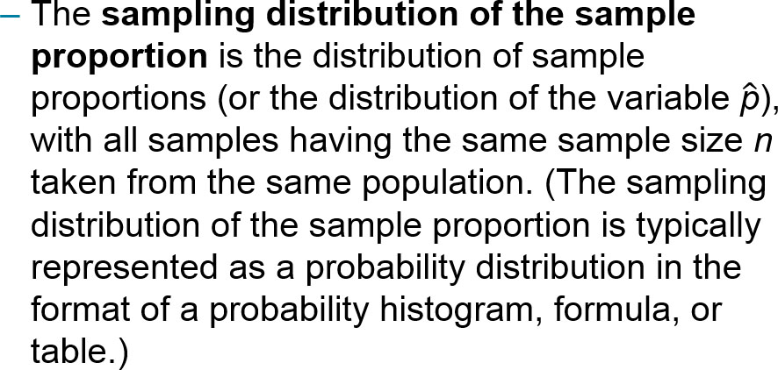
Sampling Distribution of the Sample Proportion
Sampling Distribution of the Sample Proportion

Slide 10
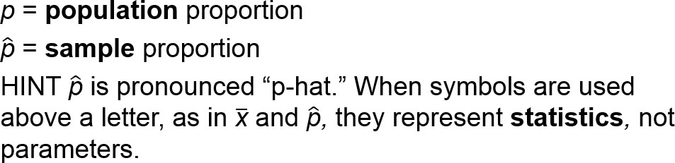
Notations for Proportions
We need to distinguish between a population proportion p and some sample proportion:

Slide 11
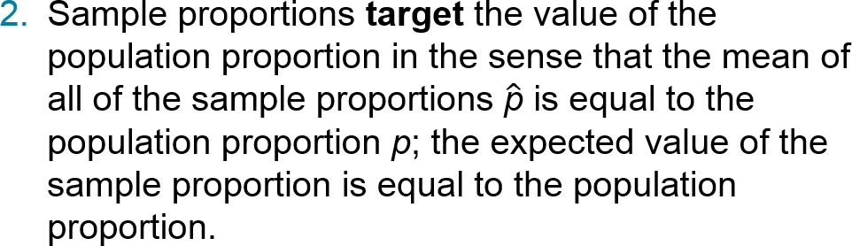
Behavior of Sample Proportions
The distribution of sample proportions tends to approximate a normal distribution.

Slide 12
Example: Sampling Distributions of the Sample Proportion (1 of 3)
Consider repeating this process: Roll a die 5 times and find the proportion of odd numbers (1 or 3 or 5). What do we know about the behavior of all sample proportions that are generated as this process continues indefinitely?

Slide 13
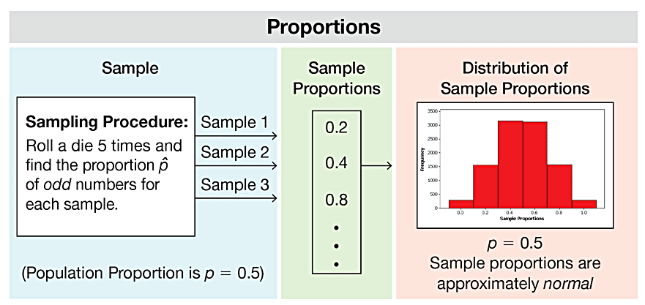
Example: Sampling Distributions of the Sample Proportion (2 of 3)
The figure illustrates a process of rolling a die 5 times and finding the proportion of odd numbers. (The figure shows results from repeating this process 10,000 times, but the true sampling distribution of the sample proportion involves repeating the process indefinitely.)
Sample Proportions from 10,000 Trials

Slide 14
Example: Sampling Distributions of the Sample Proportion (3 of 3)
The figure shows that the sample proportions are approximately normally distributed. (Because the values of 1, 2, 3, 4, 5, 6 are all equally likely, the proportion of odd numbers in the population is 0.5, and the figure shows that the sample proportions have a mean of 0.50.)
Sample Proportions from 10,000 Trials

Slide 15
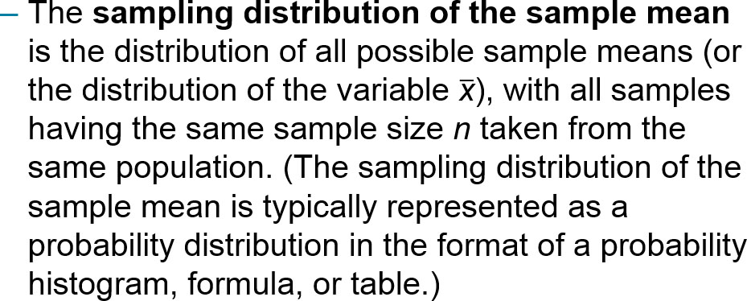
Sampling Distribution of the Sample Mean
Sampling Distribution of the Sample Mean

Slide 16
Behavior of Sample Means
The distribution of sample means tends to be a normal distribution. (This will be discussed further in the following section, but the distribution tends to become closer to a normal distribution as the sample size increases.)
The sample means target the value of the population mean. (That is, the mean of the sample means is the population mean. The expected value of the sample mean is equal to the population mean.)

Slide 17
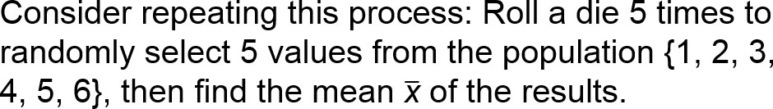
Example: Sampling Distribution of the Sample Mean (1 of 3)
What do we know about the behavior of all sample means that are generated as this process continues indefinitely?

Slide 18

Example: Sampling Distribution of the Sample Mean (2 of 3)
The figure illustrates a process of rolling a die 5 times and finding the mean of the results. The figure shows results from repeating this process 10,000 times, but the true sampling distribution of the mean involves repeating the process indefinitely.
Sample Means from 10,000 trials

Slide 19
Example: Sampling Distribution of the Sample Mean (3 of 3)
Because the values of 1, 2, 3, 4, 5, 6 are all equally likely, the population has a mean of μ = 3.5. The 10,000 sample means included in the figure have a mean of 3.5. If the process is continued indefinitely, the mean of the sample means will be 3.5. Also, the figure shows that the distribution of the sample means is approximately a normal distribution.

Slide 20
Sampling Distribution of the Sample Variance
Sampling Distribution of the Sample Variance
The sampling distribution of the sample variance is the distribution of sample variances (the variable s²), with all samples having the same sample size n taken from the same population. (The sampling distribution of the sample variance is typically represented as a probability distribution in the format of a table, probability histogram, or formula.)

Slide 21


Population Standard Deviation and Population Variance
Population standard deviation:
Population variance:

Slide 22
Behavior of Sample Variances
The distribution of sample variances tends to be a distribution skewed to the right.
The sample variances target the value of the population variance. (That is, the mean of the sample variances is the population variance. The expected value of the sample variance is equal to the population variance.)

Slide 23
Example: Sampling Distributions of the Sample Variances (1 of 4)
Consider repeating this process: Roll a die 5 times and find the variance s² of the results. What do we know about the behavior of all sample variances that are generated as this process continues indefinitely?

Slide 24
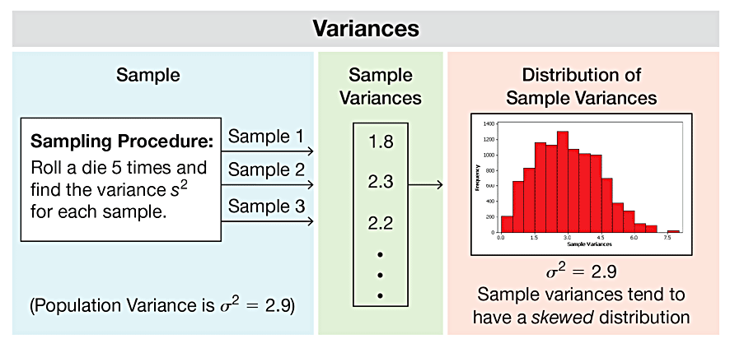
Example: Sampling Distributions of the Sample Variances (2 of 4)
The figure illustrates a process of rolling a die 5 times and finding the variance of the results. The figure shows results from repeating this process 10,000 times, but the true sampling distribution of the sample variance involves repeating the process indefinitely.
Sample Variances from 10,000 trials

Slide 25
Example: Sampling Distributions of the Sample Variances (3 of 4)
Because the values of 1, 2, 3, 4, 5, 6 are all equally likely, the population has a variance of s² = 2.9, and the 10,000 sample variances included in the figure have a mean of 2.9.
Sample Variances from 10,000 trials

Slide 26
Example: Sampling Distributions of the Sample Variances (4 of 4)
If the process is continued indefinitely, the mean of the sample variances will be 2.9. Also, the figure shows that the distribution of the sample variances is a skewed distribution, not a normal distribution with its characteristic bell shape.
Sample Variances from 10,000 trials

Slide 27
Estimator
Estimator
An estimator is a statistic used to infer (or estimate) the value of a population parameter.

Slide 28
Unbiased Estimator
Unbiased Estimator
An unbiased estimator is a statistic that targets the value of the corresponding population parameter in the sense that the sampling distribution of the statistic has a mean that is equal to the corresponding population parameter.

Slide 29
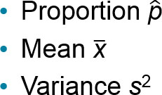
Estimators: Unbiased and Biased (1 of 2)
Unbiased Estimator
These statistics are unbiased estimators. That is, they each target the value of the corresponding population parameter (with a sampling distribution having a mean equal to the population parameter):

Slide 30
Estimators: Unbiased and Biased (2 of 2)
Biased Estimator
These statistics are biased estimators. That is, they do not target the value of the corresponding population parameter:
Median
Range
Standard deviation s

Slide 31
Why Sample with Replacement?
Sampling is conducted with replacement because of these two very important reasons:
When selecting a relatively small sample from a large population, it makes no significant difference whether we sample with replacement or without replacement.
Sampling with replacement results in independent events that are unaffected by previous outcomes, and independent events are easier to analyze and result in simpler calculations and formulas.

